Slide 1



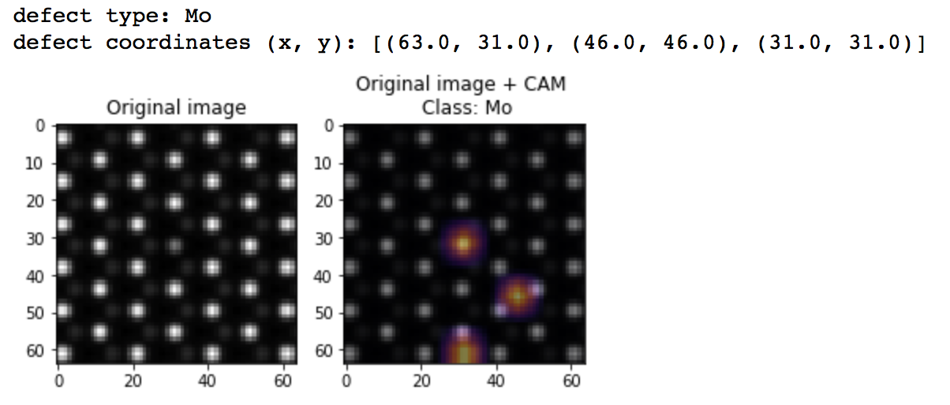

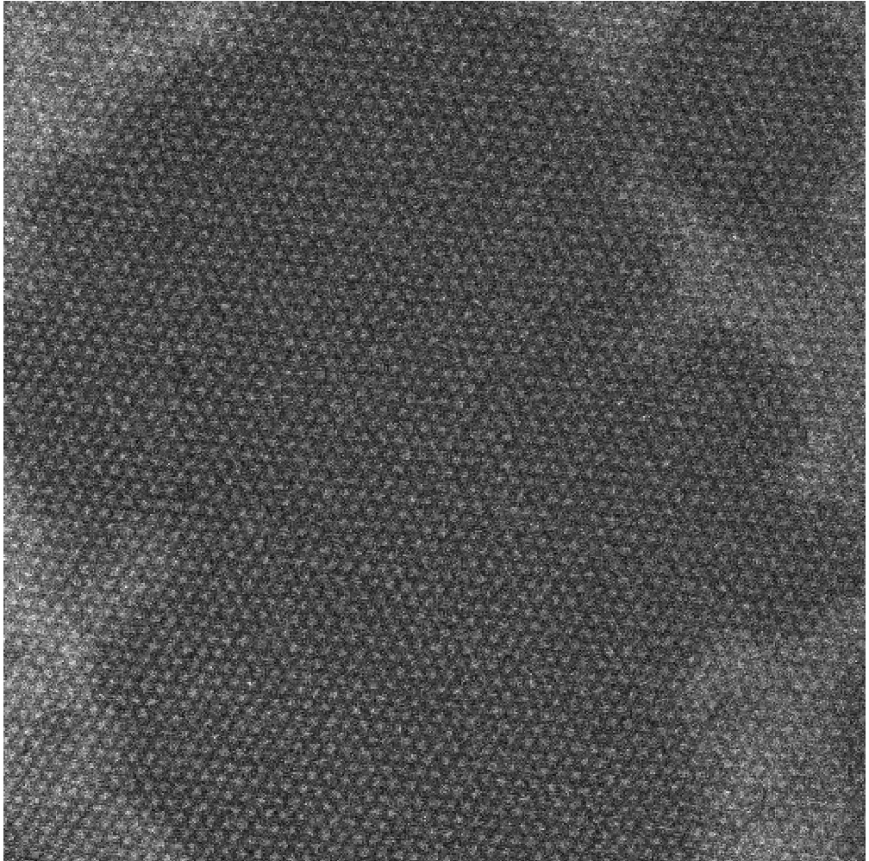
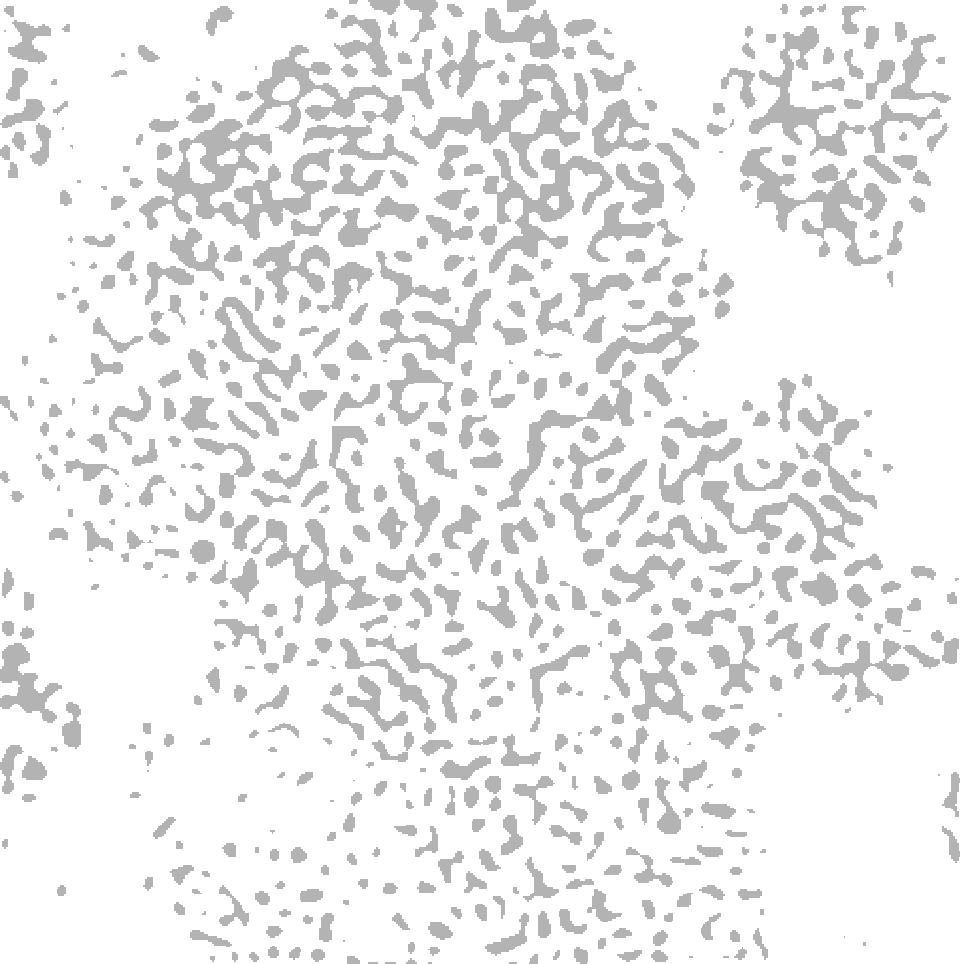
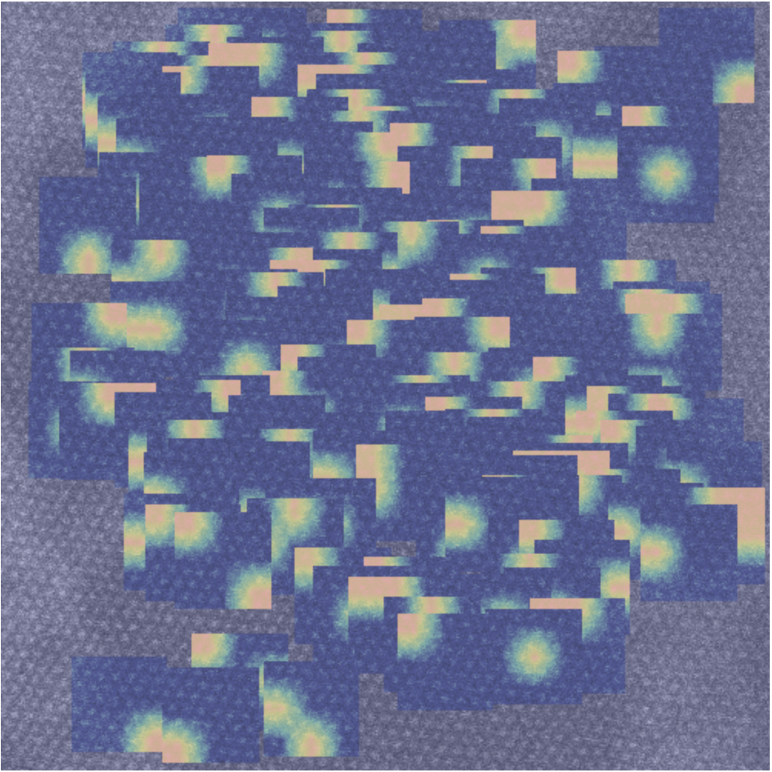
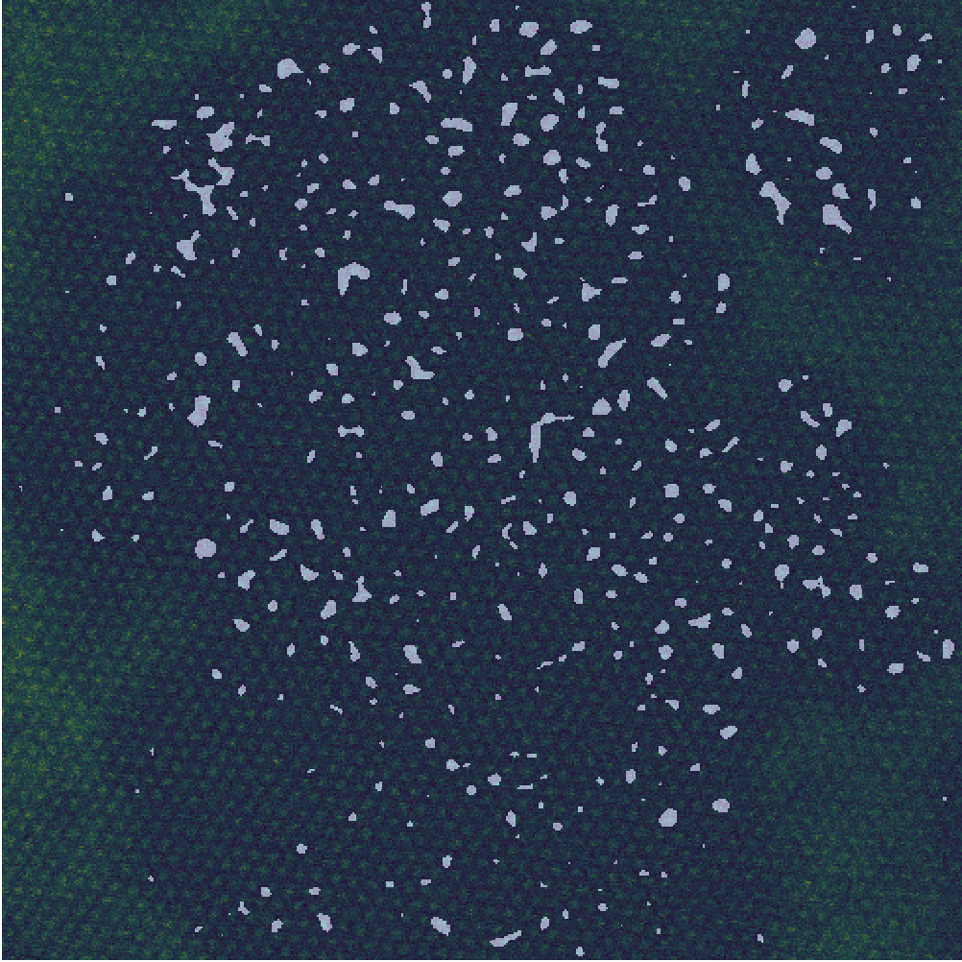
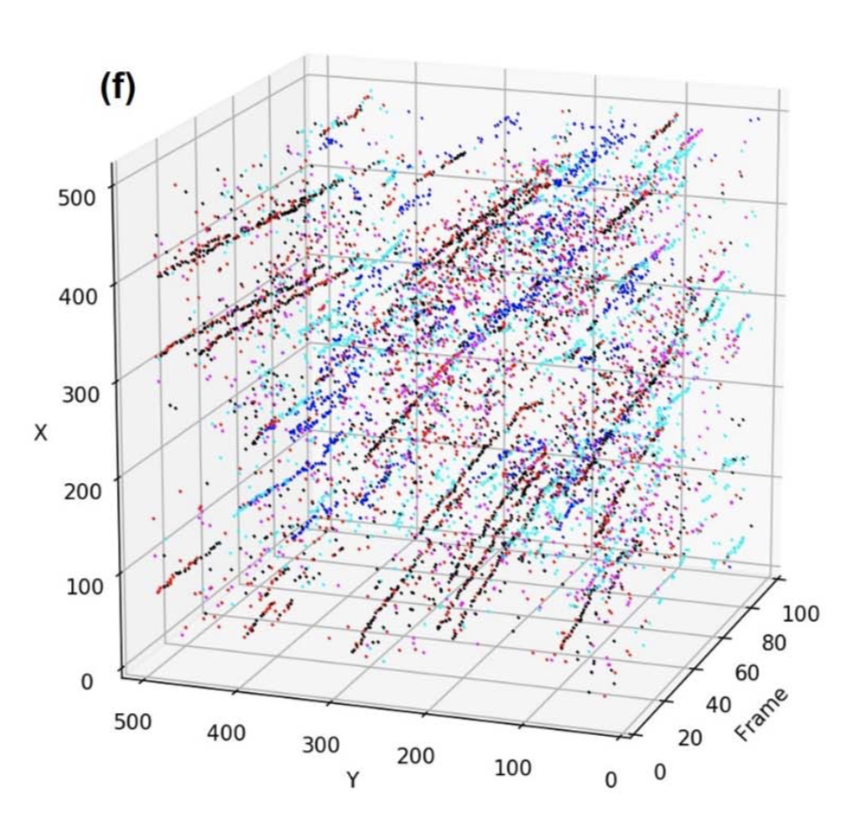
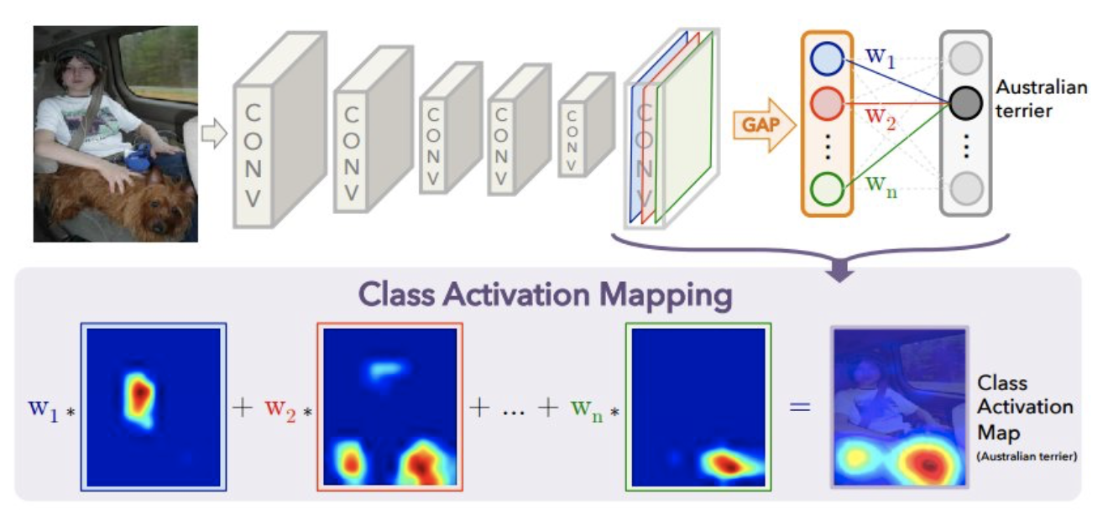

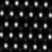
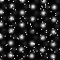
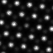
Deep Learning of Solid-State Transformations and Reaction Pathways in 2D Materials
Sarthak Jariwala, Jimin Qian and Yiwen Wu
Department of Materials Science and Engineering
University of Washington, Seattle, WA
Background:
Recent advances in scanning transmission electron microscopy (STEM) have allowed unprecedented insight into the elementary mechanisms behind the solid-state phase transformations and reactions. However, the ability to quickly acquire large, high-resolution datasets has created a challenge for rapid physics-based analysis of STEM images and movies.
What we do:
In this project, we developed a convolutional-neural-network-based framework for automated localization, classification and visualization of the defects in 2D materials from dynamic STEM data.
Training CNN on simulated STEM data:
A convolutional neural network is trained on the training date generated during the preprocessing. The architecture of CNN is shown below.
Hyperparameters Tuning is conducted to determine the optimized value of learning rate, momentum, etc. The validation and test accuracy of the best CNN are over 0.90, which indicates that this model fit well to the training data and has good generative predict ability on the simulated STEM images.
Training CNN on experimental STEM data:
Though the CNN trained on simulated STEM data have a remarkable ability to make prediction on image-level labels and the CAM enables the ability to localize the defect in each simulated STEM image, it cannot be directly apply to experimental STEM data.
A new CNN was trained to localize the defects in experimental STEM data. The workflow is shown below.
A Fourier method is performed to find the defect area in a selected experimental STEM image. The result will be served as a ground truth to train a CNN later.
A CNN was trained to localize the defects. Note that this CNN provide a pixel-wise prediction on each experimental STEM image.
Crop the experimental STEM image into windows with shape of 64*64, which fulfill the required input shape of the CNN we trained on simulated data.
Make Prediction on experimental data:
Now the CNN we trained on simulated STEM data can be applied to the cropped experimental images.
Simulated data:
45 simulated STEM images of WS2 with shape of 64*64. Each image contains only one type of defect. The defect types include Mo dopant, S vacancy, W vacancy, W dopant.
Experimental data:
Dynamic experimental STEM data of WS2 with shape of 512*512.
Visualization:
1)Insert the CAM back to the experimental STEM movie.
2)Visualize how different type of defect involve with time.
 | training | validation | test
accuracy | 1.00 | 0.96 | 0.90
Class Activation Map(CAM):
Class activation map is a method that enables the convolutional neural network to have remarkable localization ability despite being trained on image-level labels. The figure below illustrates how CAM works(B. Zhou, A. Khosla, A. Lapedriza, A. Oliva, and A. Torralba. Learning Deep Features for Discriminative Localization. CVPR'16 (arXiv:1512.04150, 2015).)
Image Preprocessing:
Do data augmentation on simulated data to generate a training dataset with 51125 images. Each images are added gaussion, s&p, poisson and speckle noise. To generate the training data, each images are labeled with its defect type.

